Slide 1

CS621 Spatial Databases Project
New York Gun Crime 2020
By Jack Hickey
20253050

Slide 2
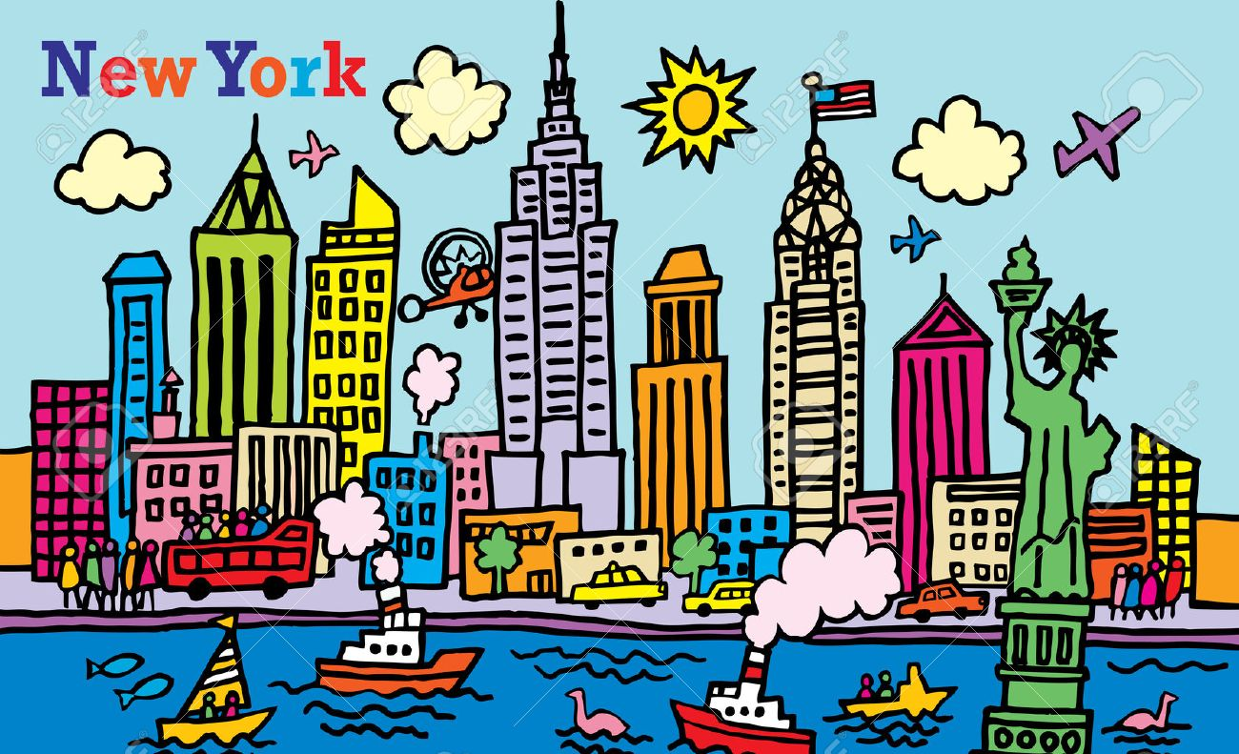
The project
Coming up…
Shootings in NYC 2020
Worst areas?
Possible causes?
Alcohol
Population density
Holidays
Data was obtained online from ‘NYC OPEN DATA’ and Overpass-Turbo.

Slide 3
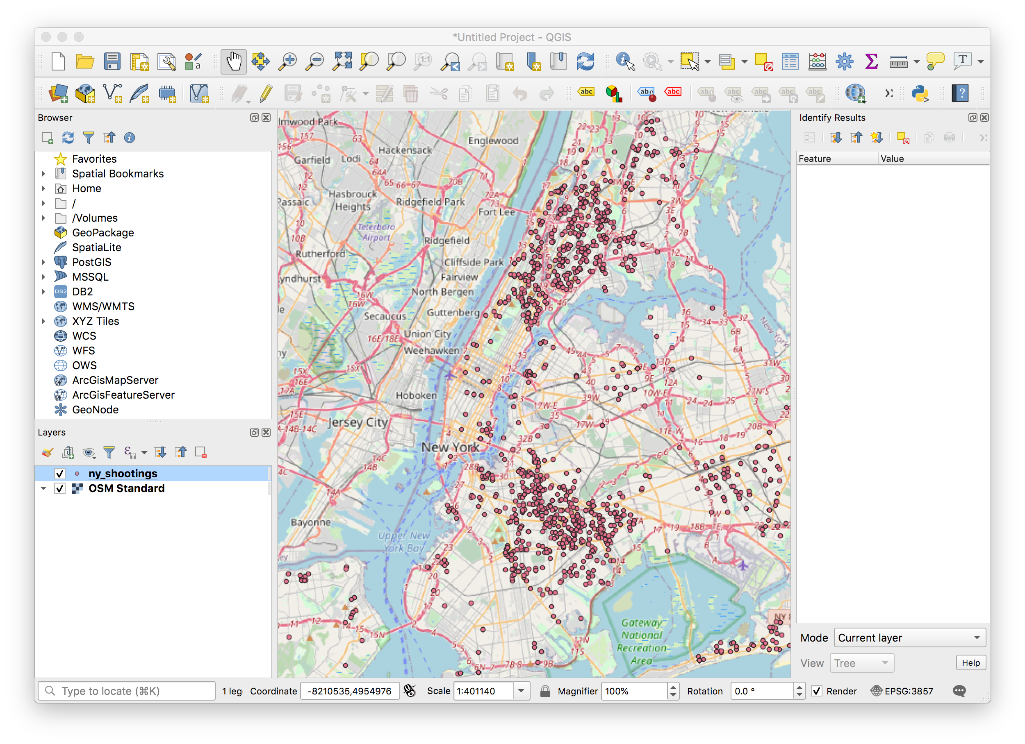
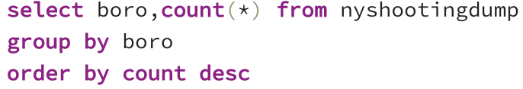
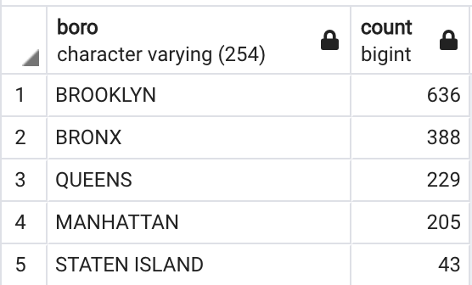
General overview of NY Shootings

Slide 4
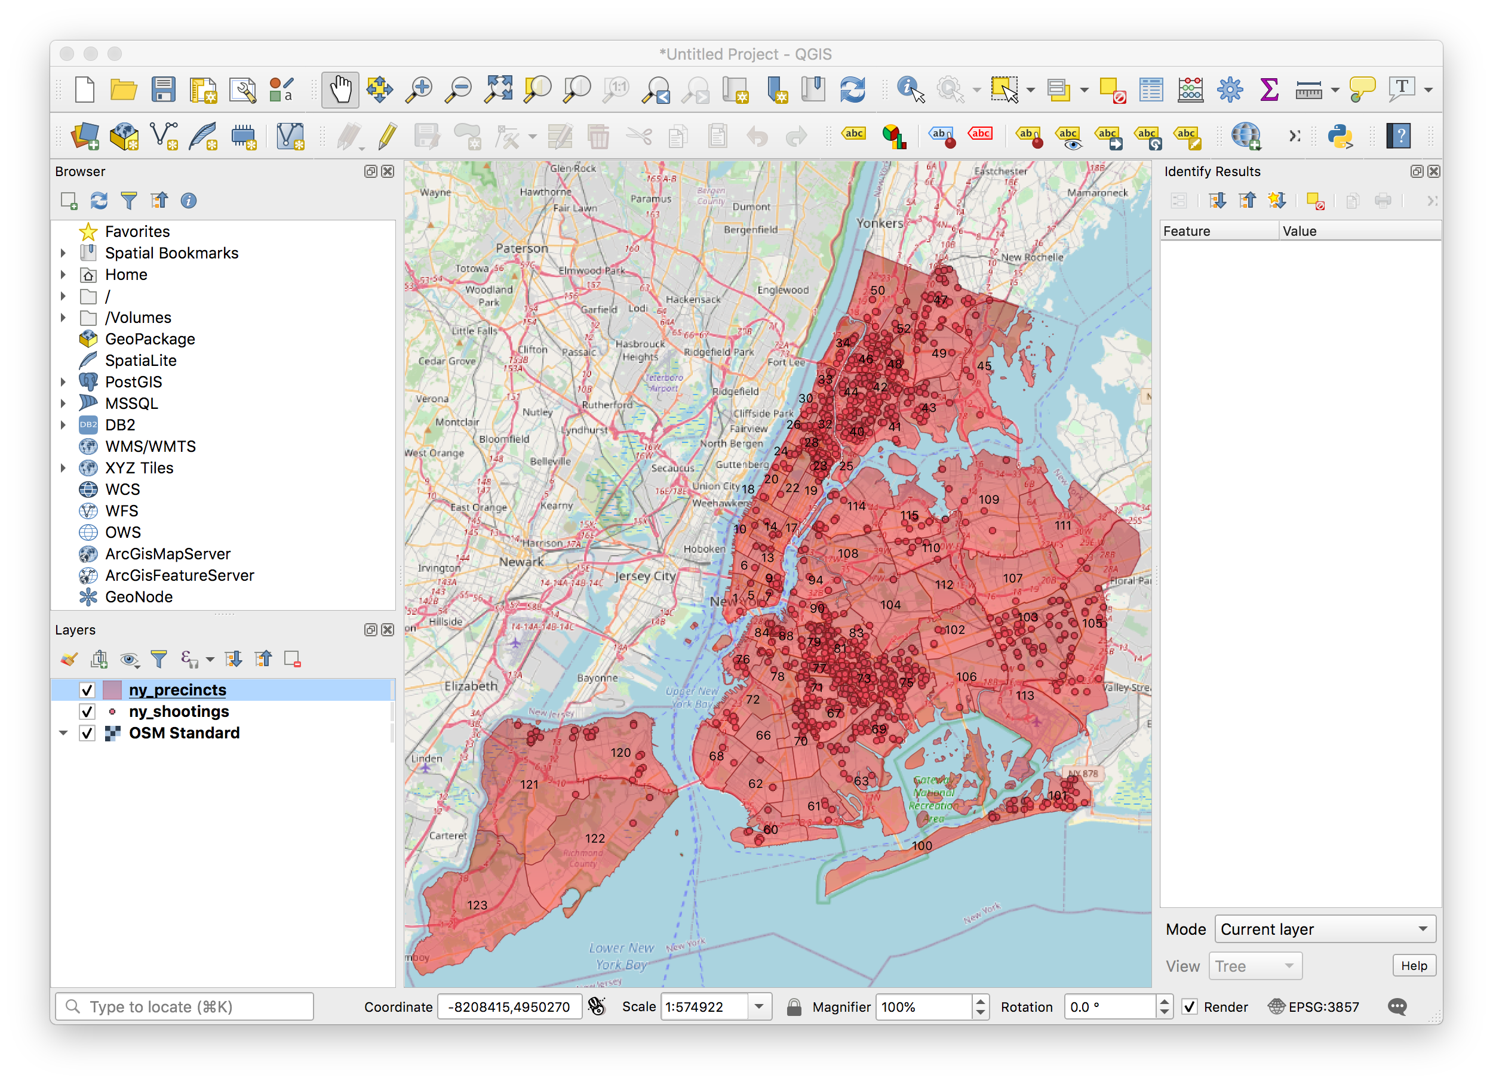
Adding the precincts
Now we have a clearer view on the more
‘dangerous’ areas in terms of shootings
Brooklyn and The Bronx seem the busiest
Which is our busiest/quietest precincts?

Slide 5
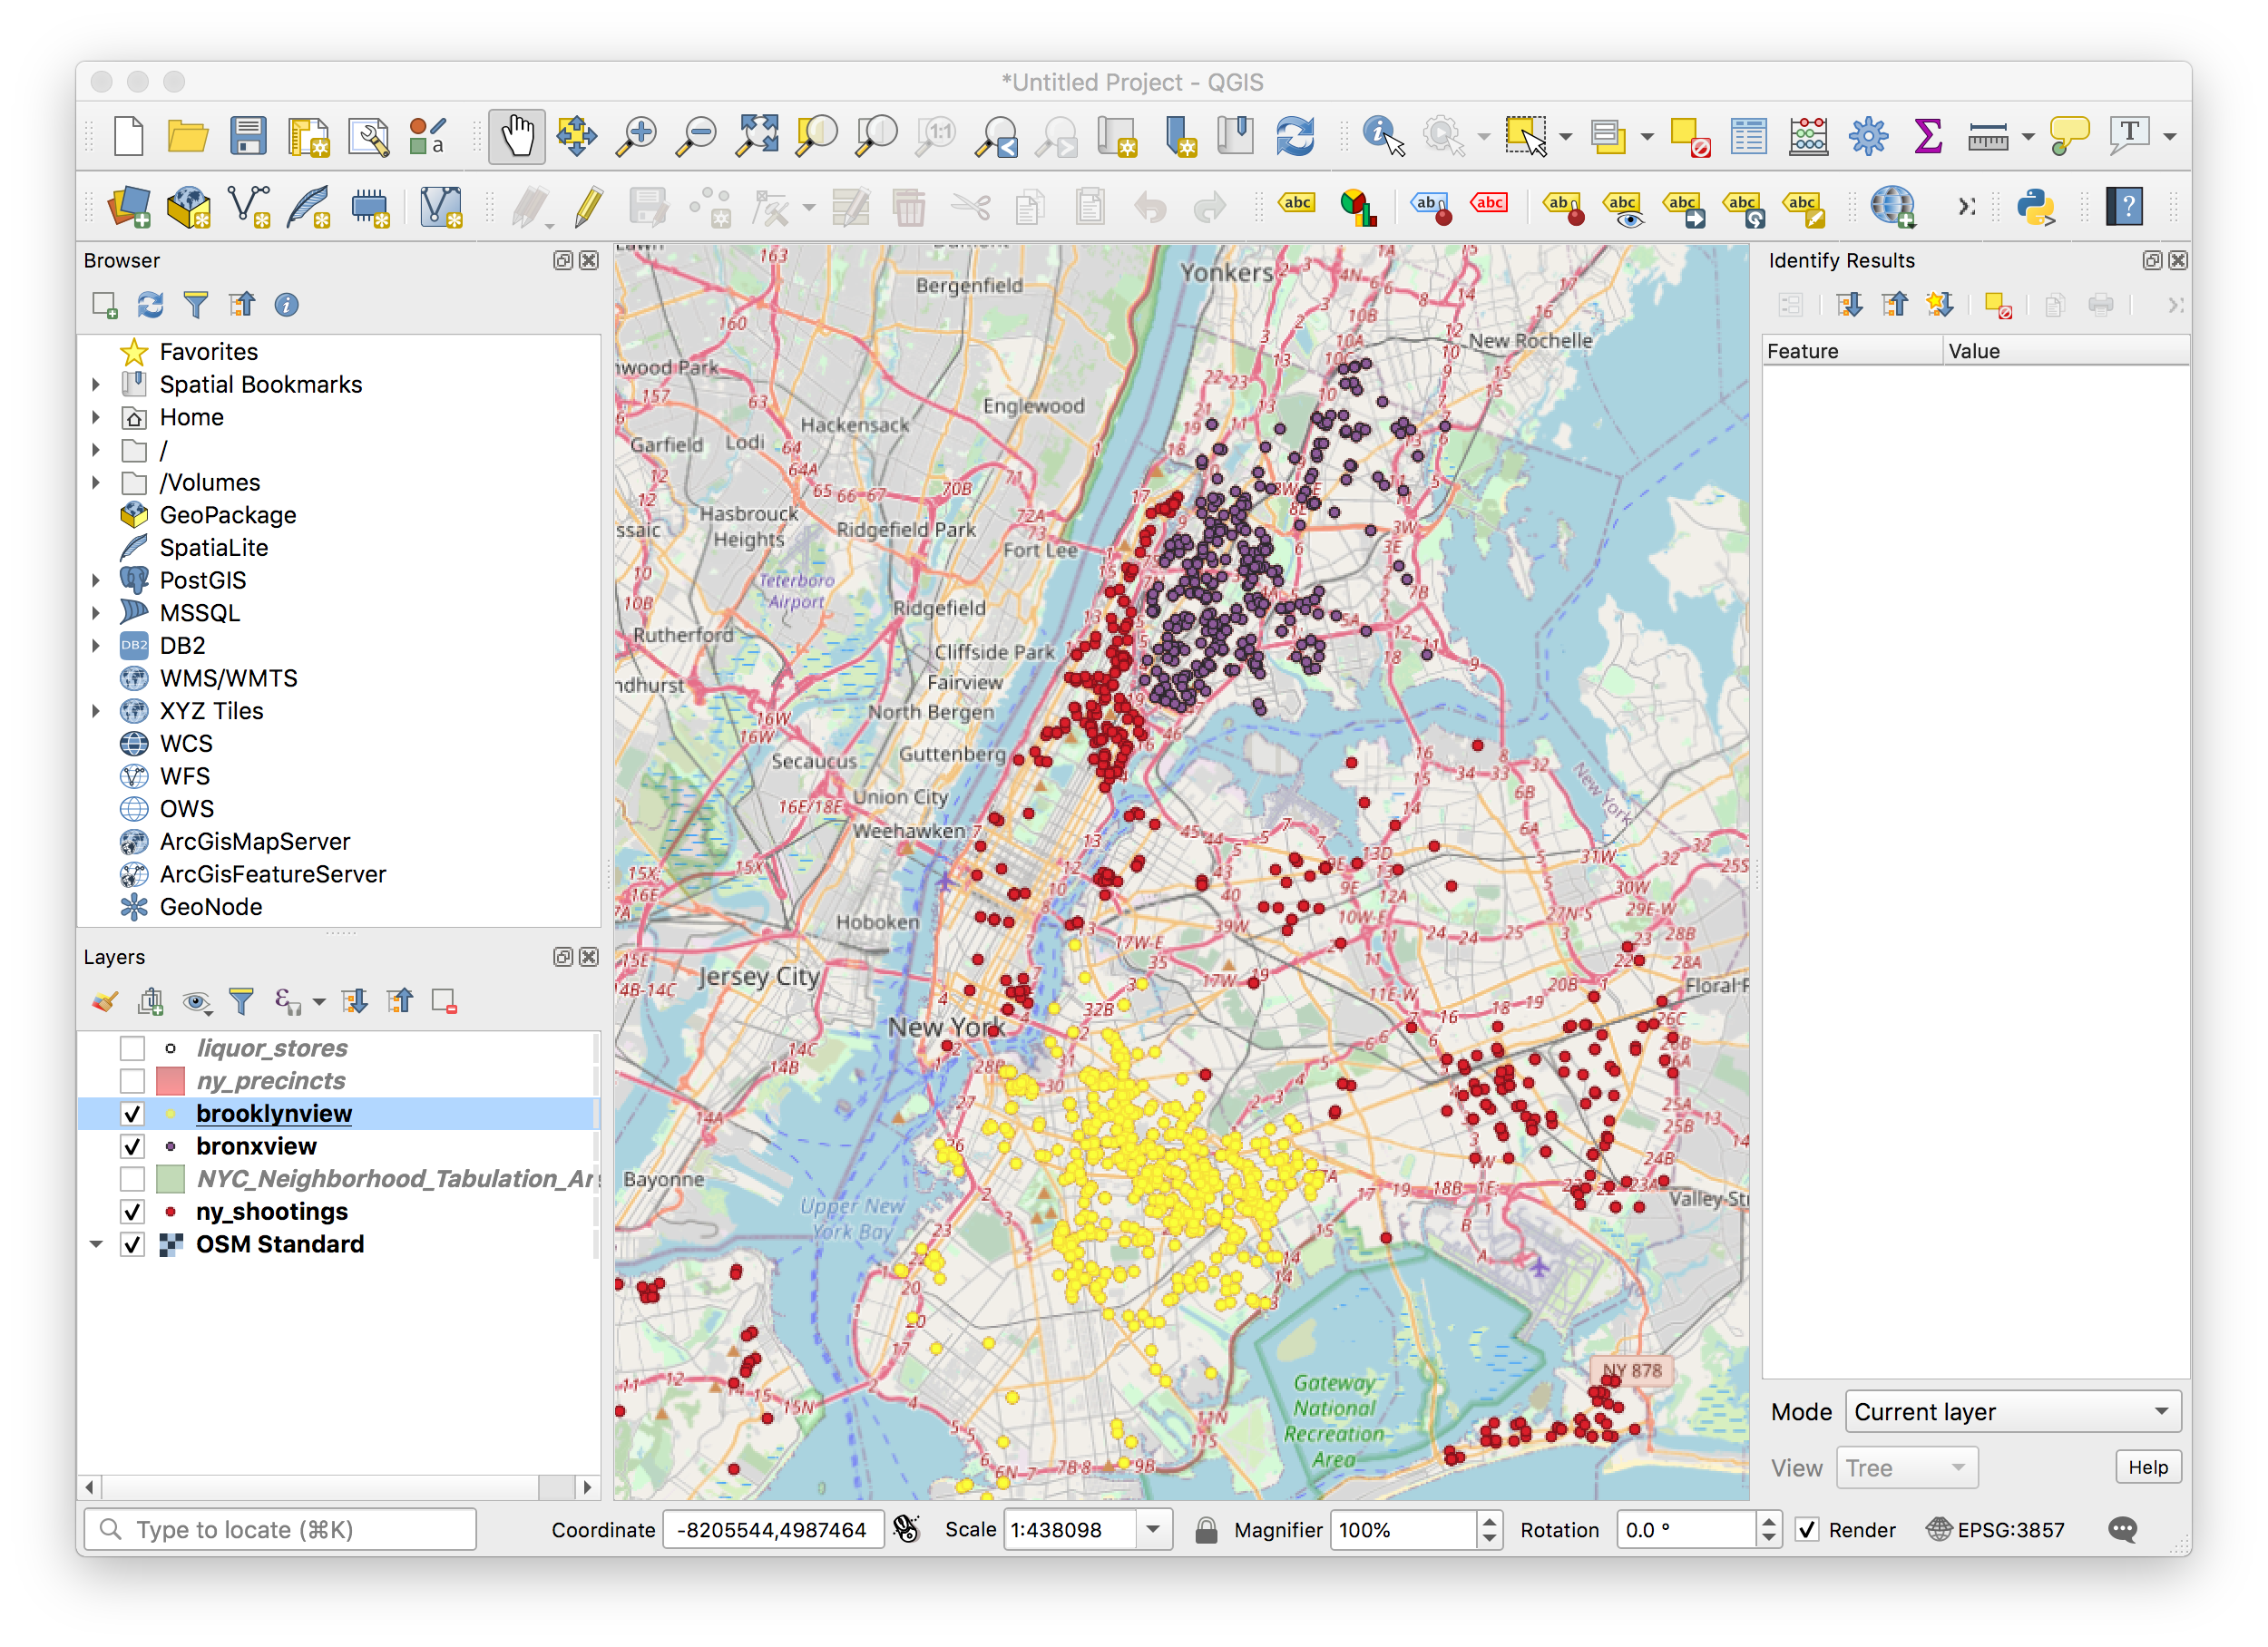
Create views to show Brooklyn and the Bronx in different colours
DROP VIEW IF EXISTS BronxView;
CREATE OR REPLACE VIEW BronxView AS
SELECT nyj.ogc_fid as Join_ID, nyj.boro as boro,
nyj.total_precinct_pop as precinct_pop, nyj.geom as shooting_geom, nyp.ogc_fid as Precinct_ID, nyp.precinct as precinct
FROM nycjoin as nyj, nyprecincts as nyp,
WHERE ST_Contains(nyp.geom,nyj.geom) and nyj.boro = 'BRONX';

Slide 6
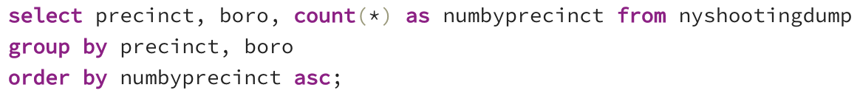
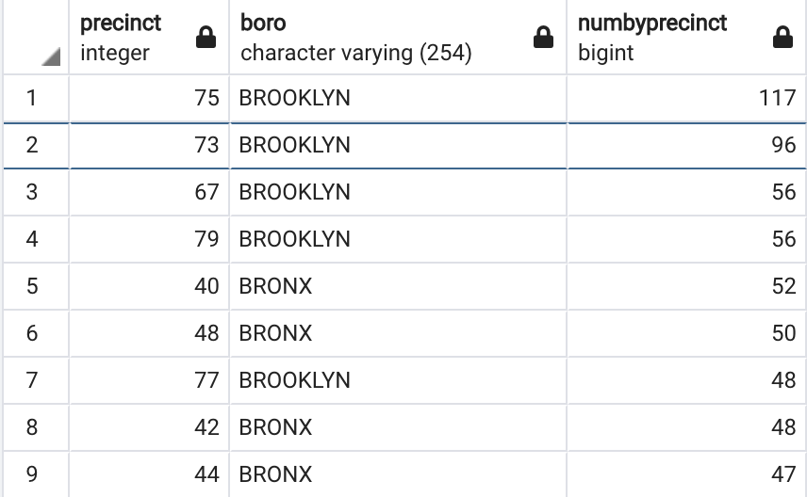
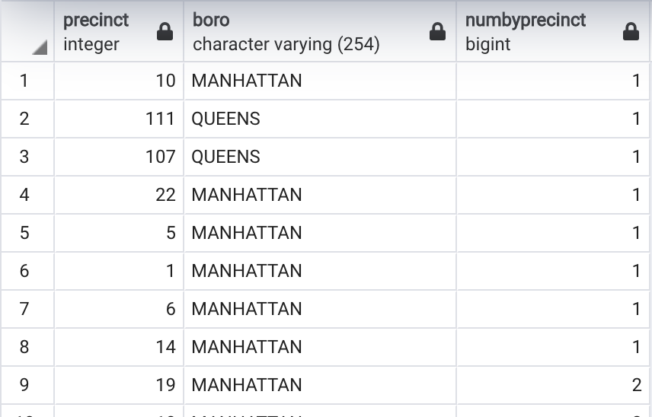
Activity rates of the precincts

Slide 7
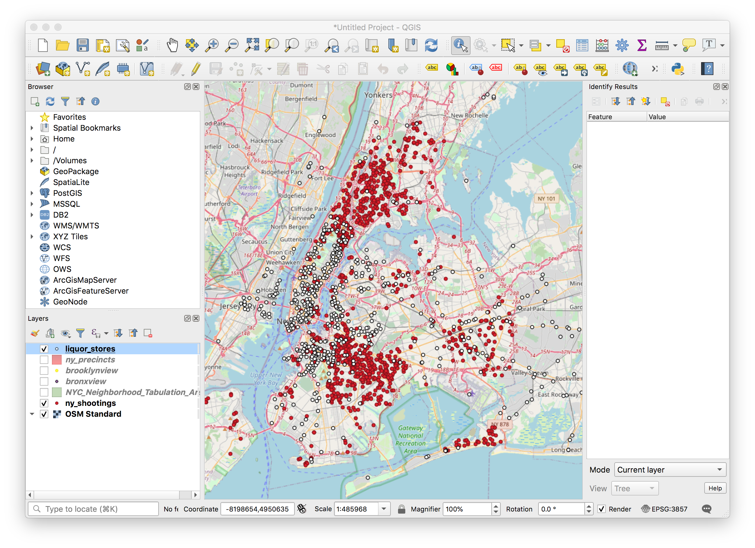
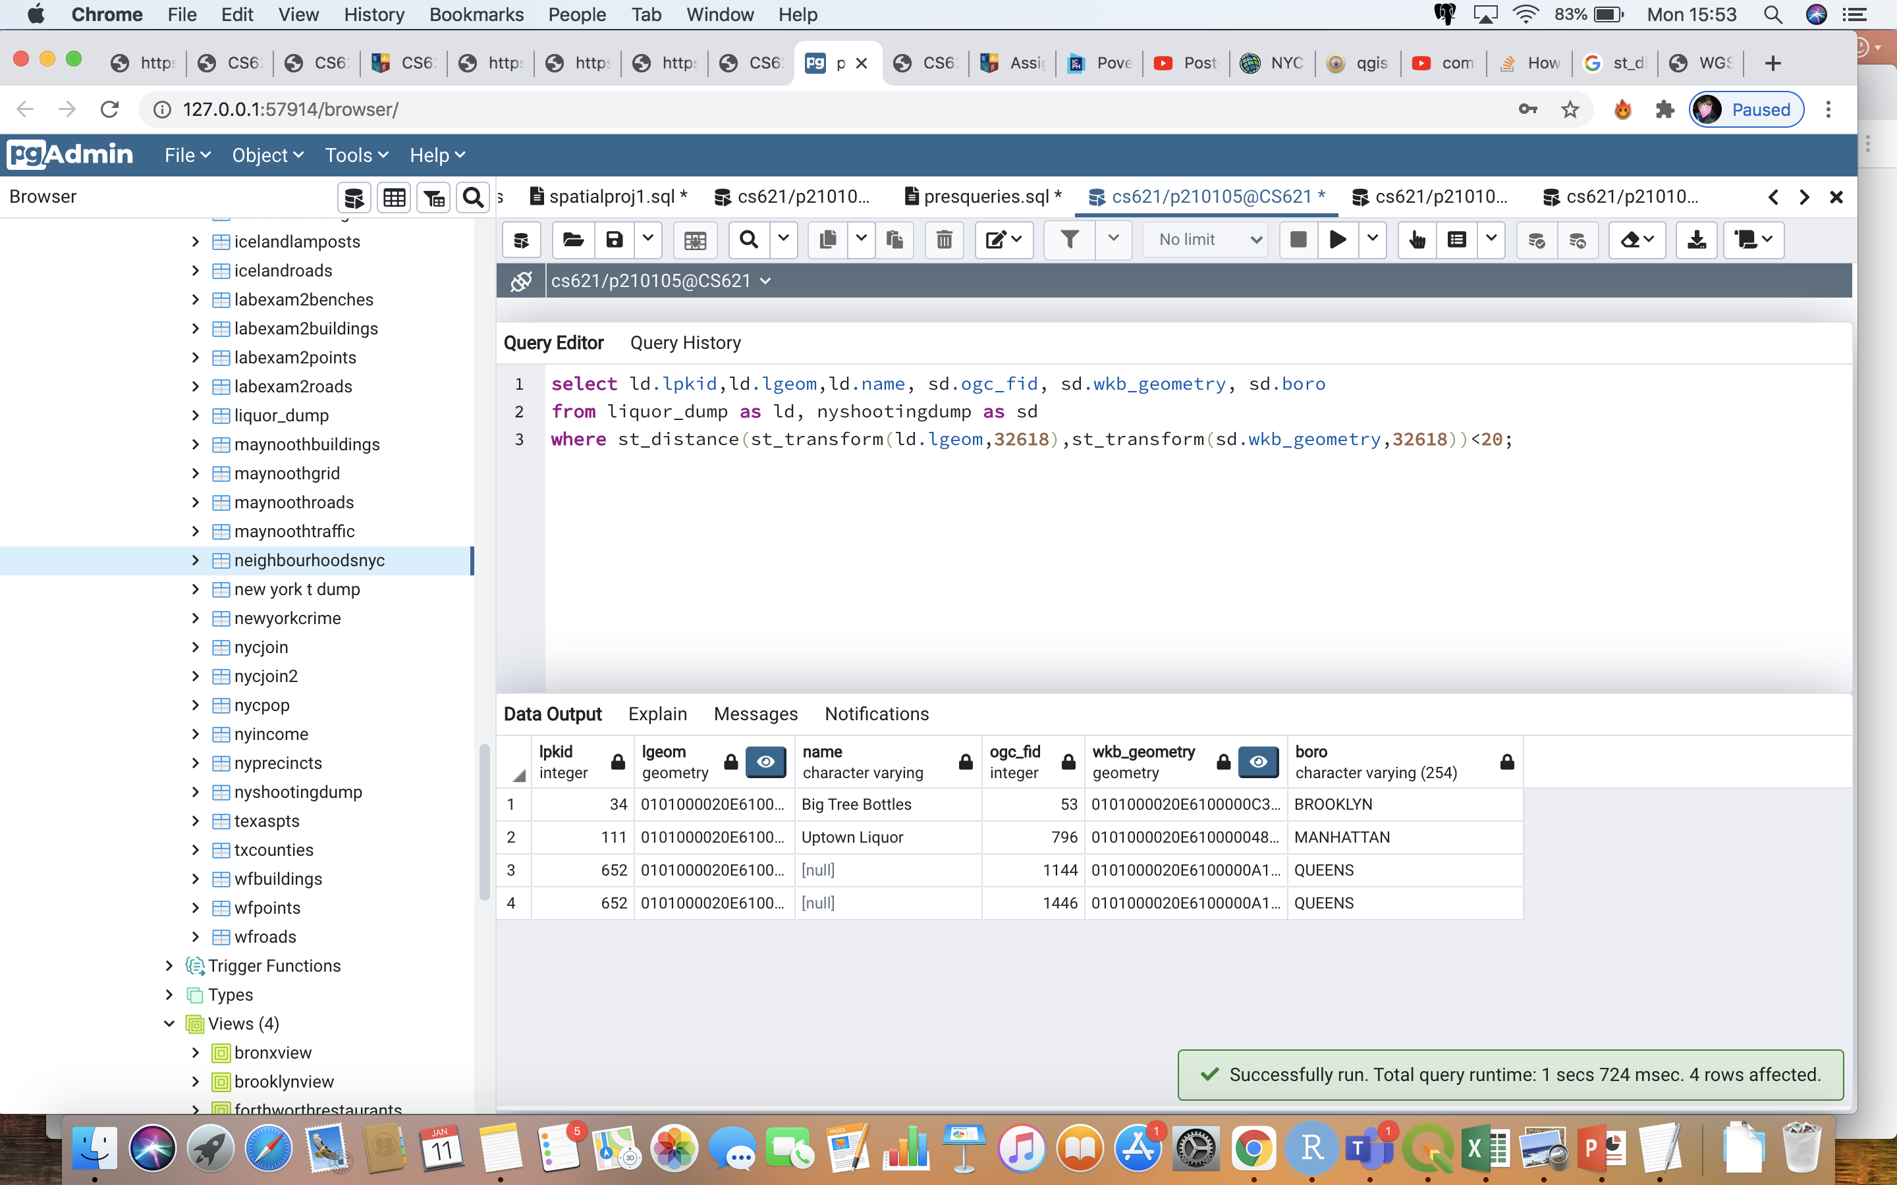
Comparison of reported shootings to liquor stores around New York
Only 4 reported shootings within 20m of a liquor store!!!

Slide 8
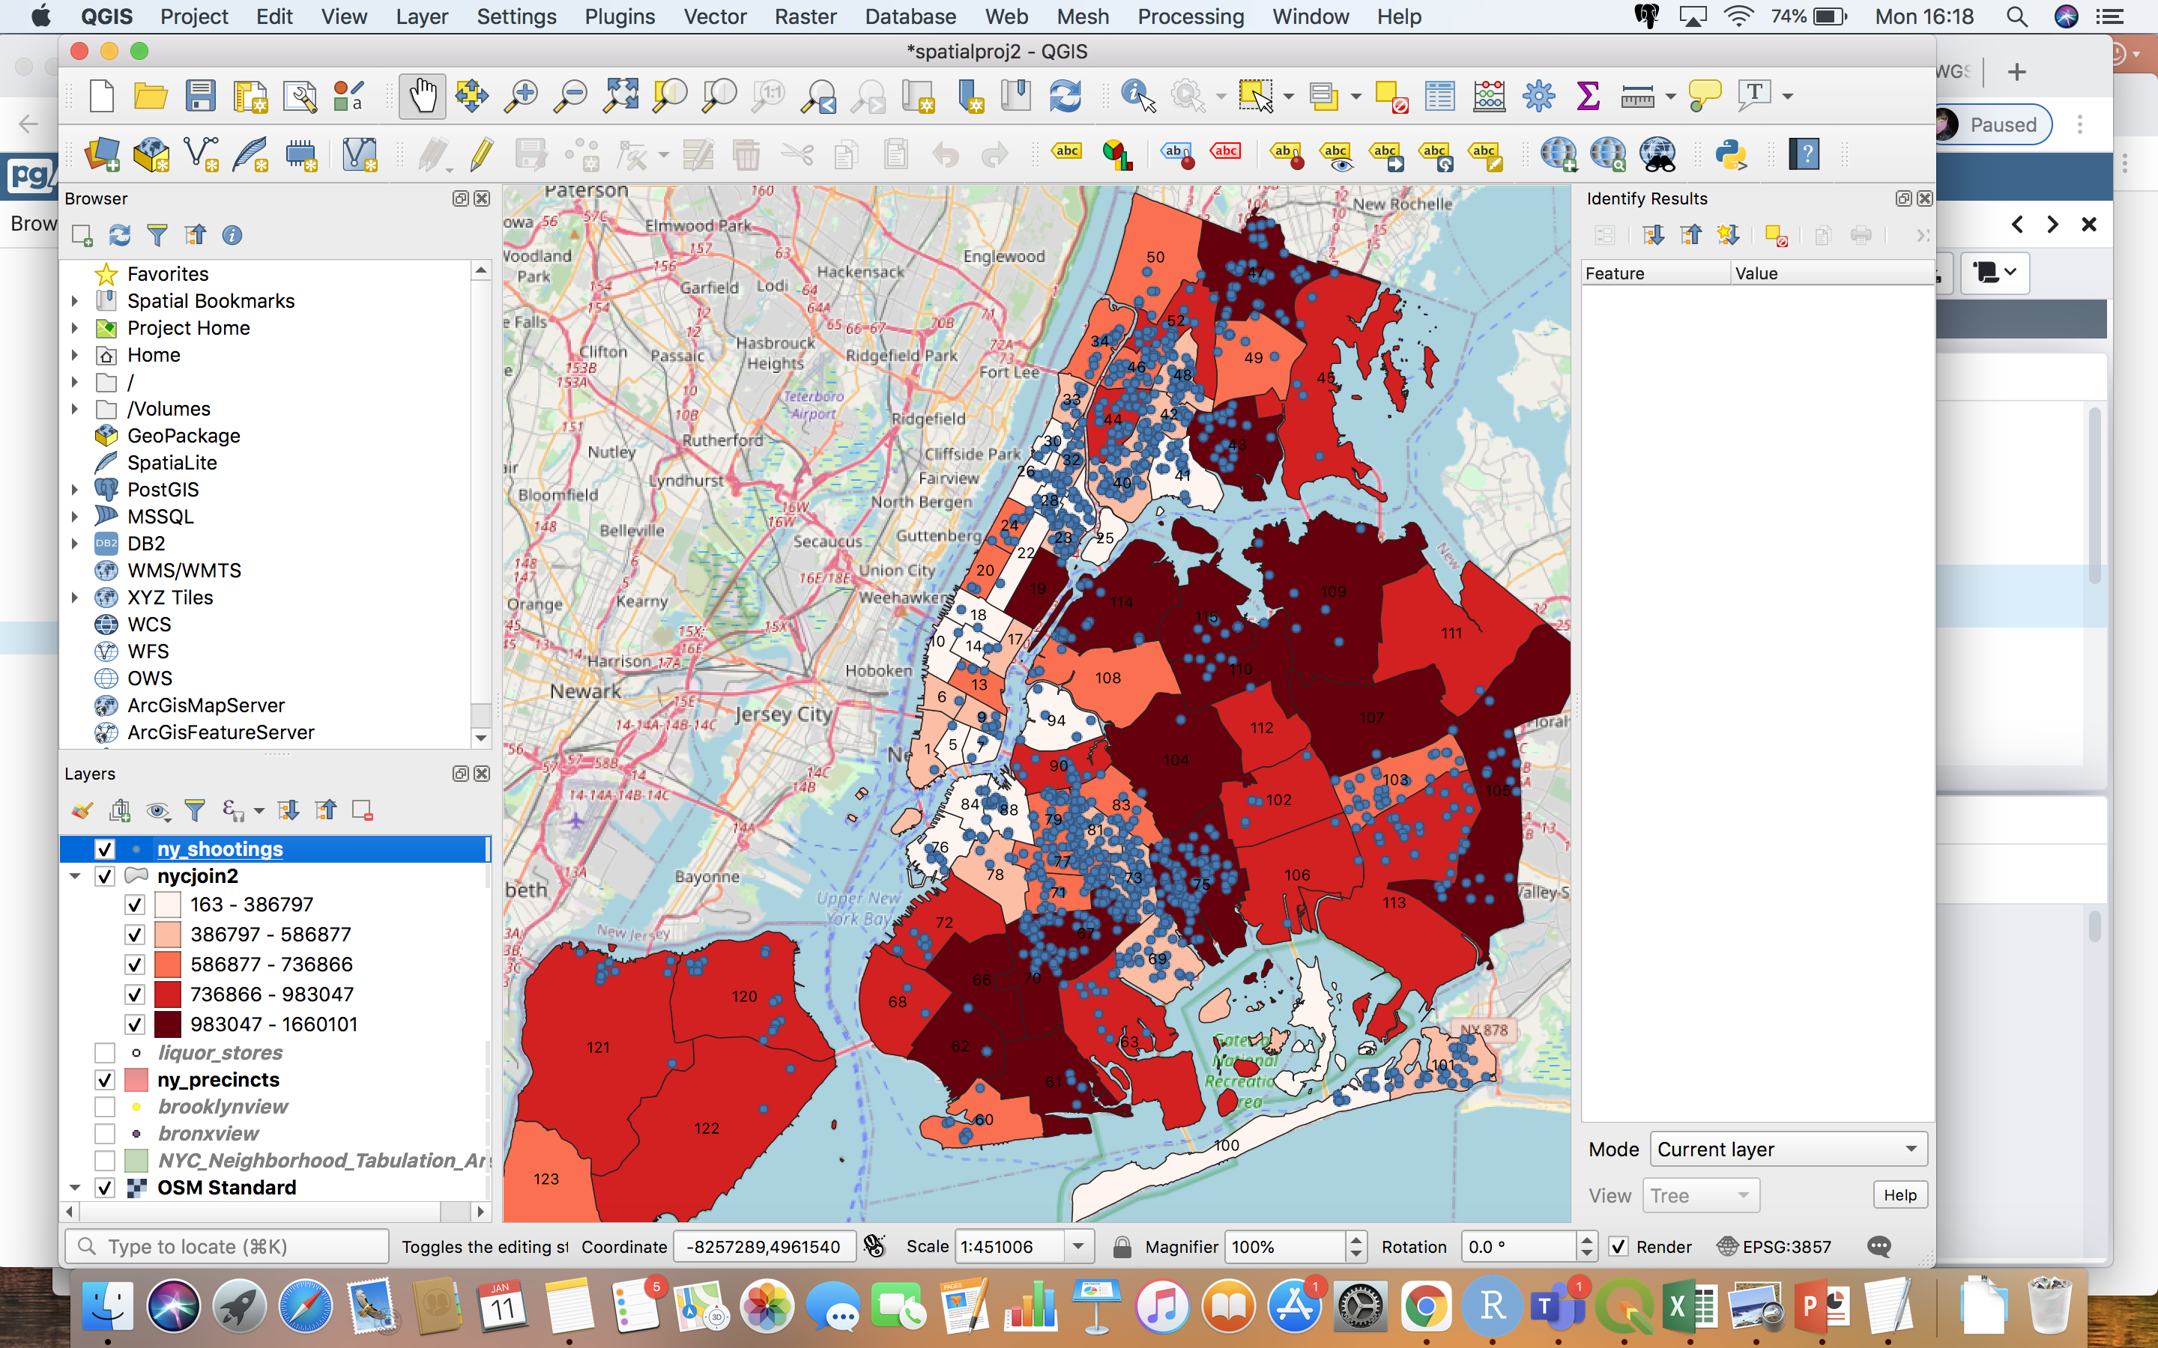
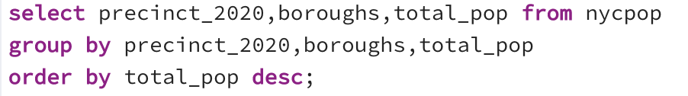
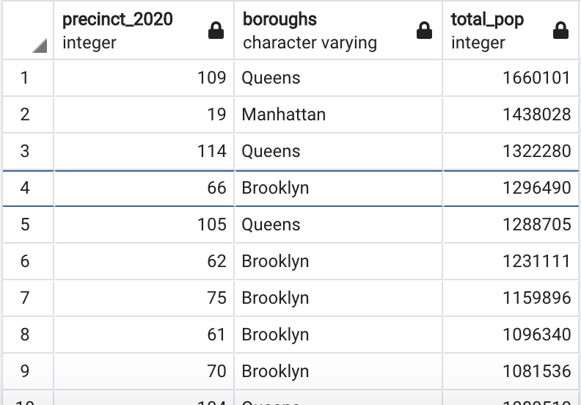
Are there more shootings in the highly populated areas?

Slide 9
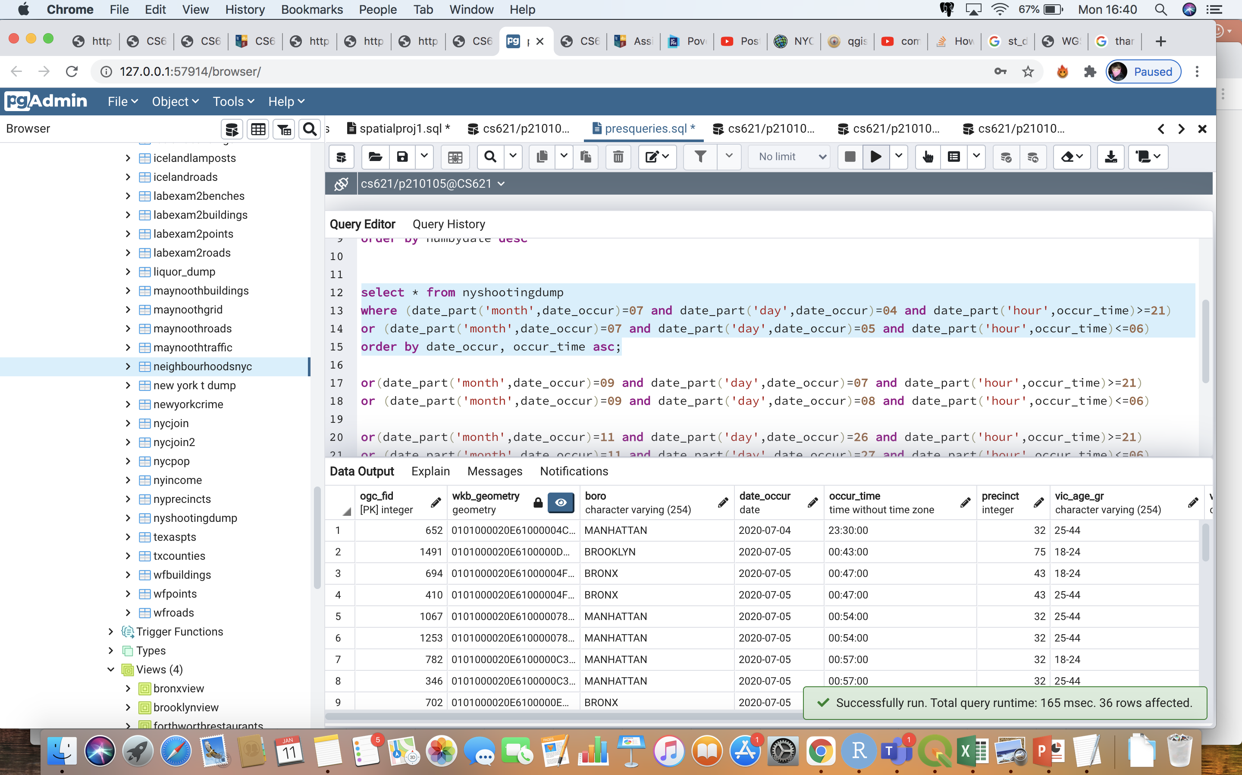

Shooting incidents around U.S holidays
4th of July seems to be the busiest day/night for shootings over all of 2020

Slide 10
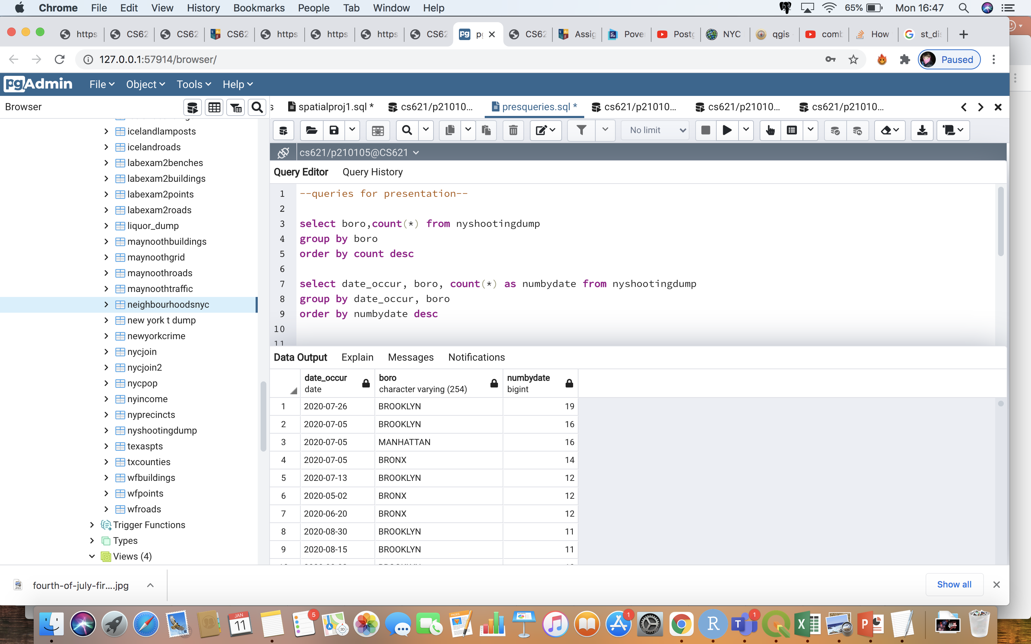
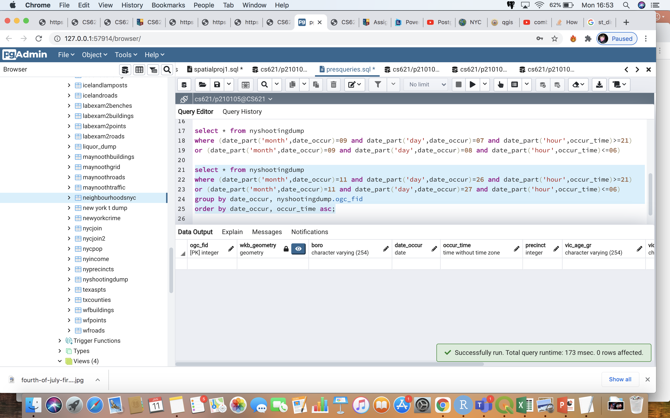
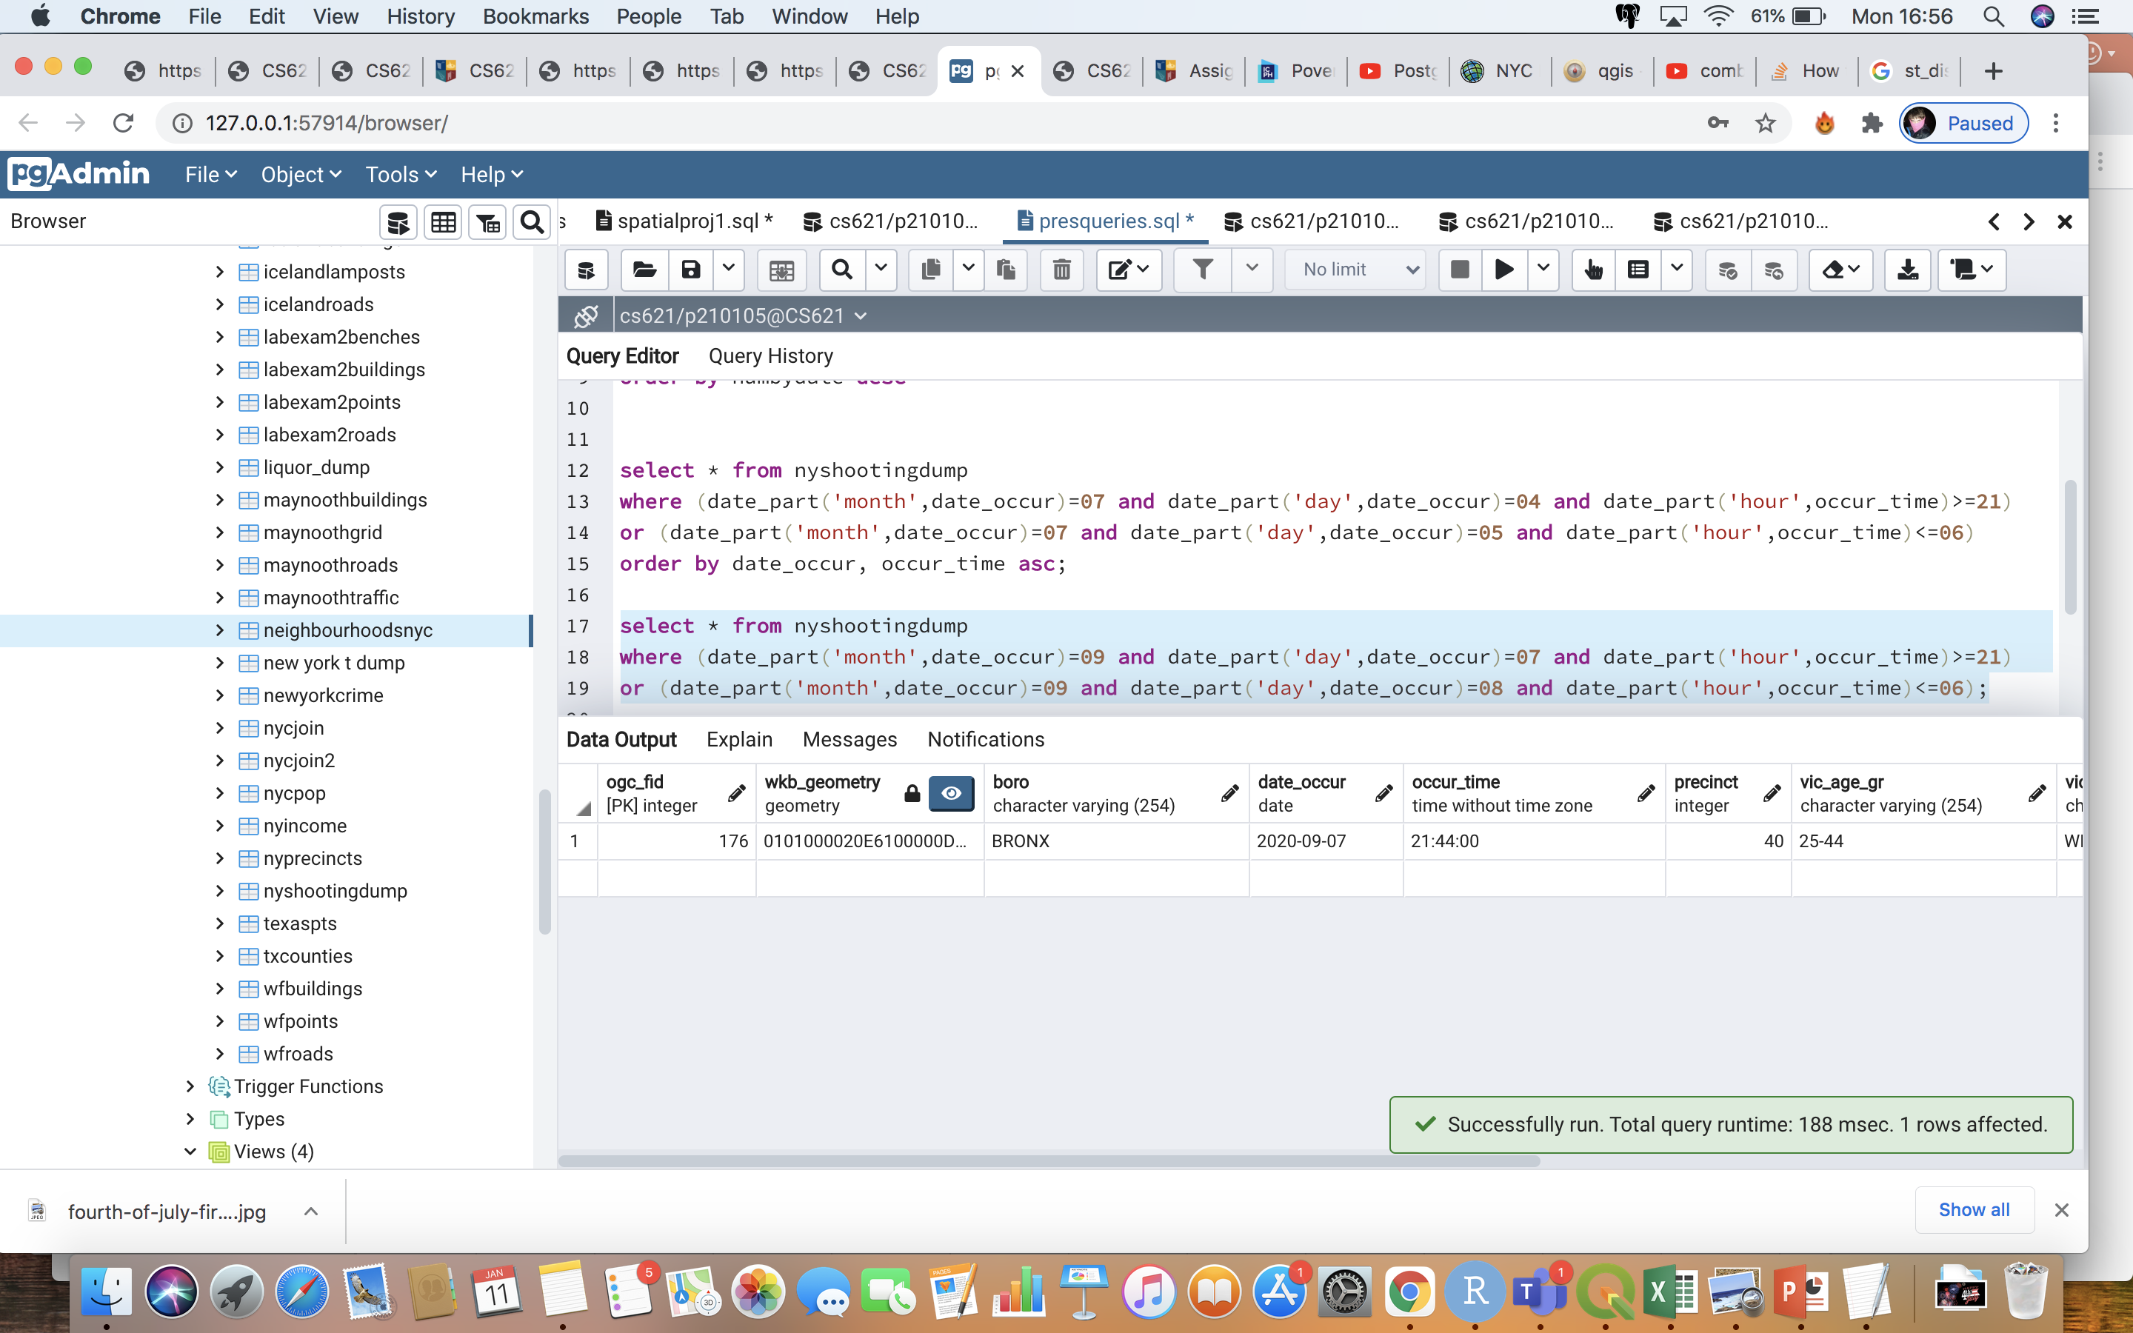
St. Patrick Day
Labour Day

Slide 11
So New York’s gun crime crisis isn’t entirely straightforward…
Liquor stores surprisingly seem to have little effect
Densely populated areas only provide some answers
4th of July appears to be part of the problem, but St. Patricks day provided no shootings to the record.
I see that mixture of societal issues like these, as well as poverty need to all be considered to begin answering questions regarding gun crime in New York.

